Slide 1



AN OFFERING IN THE BLUE CYBER SERIES
DOD SBIR/STTR
Mentor Protégé Program
Presented by David Sikora
14 February 2023
#35 IN THE BLUE CYBER EDUCATION SERIES
Notes:
Photo source Photo by: Air Force photo | VIRIN: 201002-F-ZX772-001.JPG https://www.afnwc.af.mil/News/Photos/igphoto/2002520957/

Slide 2
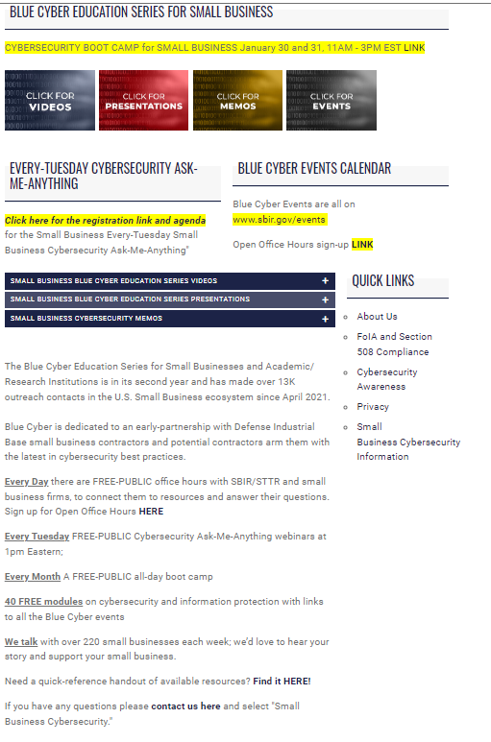
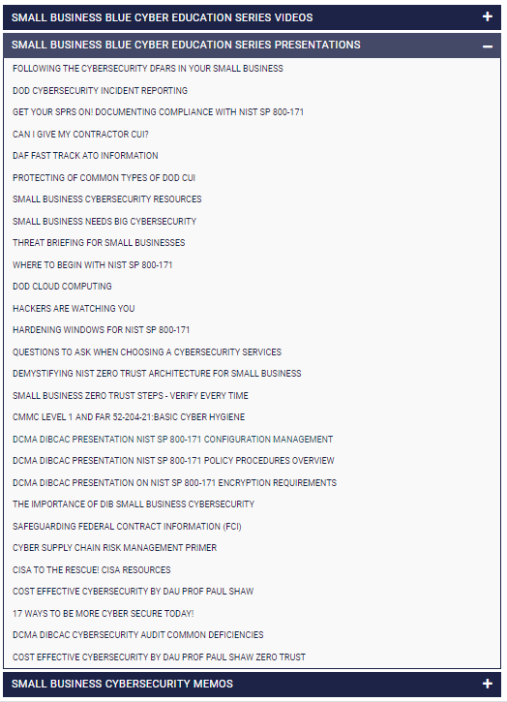
The slides are located at: www.safcn.af.mil/CISO/Small-Business-Cybersecurity-Information/
Notes:
This presentation we are about to see is located here on the Blue Cyber webpage, under “Presentations”.

Slide 3
Mentor Protégé Program
Mr. David Sikora
SAF/SB
Feb 2023
Version 2.0

Slide 4
Partnership Authorities
Alliances
Contracts
Government to Government
Government to Industry
National Defense Authorization
Act for FY 2011
Stevenson-Wydler Technology Innovation Act of 1980
Rapid Innovation Fund (RIF) Program
CPP
Grants
Cooperative Agreements
National Defense Authorization Act for FY 1994
Bayh-Dole Act of 1980
CTA
Authorizations
Patent License Agreement (PLA)
PLA
National Defense Authorization Act for FY 1993
Dual Use
Small Business Innovation Development Act of 1982
SBIR
Small Business Research and Development Act for FY 1992
STTR
Federal Technology Transfer Act of 1986
CRADA
National Defense Authorization Act for FY 1991
Mentor-Protégé
IR&D
EPA
National Competitiveness Technology Transfer Act of 1989
Education Outreach
OTA
Other Transaction Authority (OTA)
Partnership Intermediaries (PIA)
TIA
Partnership Intermediaries (PIA)
Technology Investment Agreement (TIA)
Notes:
Plus RIF

Slide 5
Program Purpose
The Department of the Air Force (DAF) Mentor-Protégé Program (MPP) provides incentives for Mentor Firms to furnish small business concerns (Protégé Firms) with assistance designed to:
Enhance the capabilities of Protégé Firms to perform as subcontractors and suppliers under Department of Defense (DoD) contracts and other contracts and subcontracts;
Increase participation of Protégé Firms as subcontractors and suppliers under DoD contracts, other Federal Government contracts, and commercial contracts; and
Foster the establishment of long-term business relationships between Protégé Firms and their Mentor Firms.
Under this program, approved Mentor Firms will enter into Mentor Protégé Agreements (MPAs) with eligible Protégé Firms and provide technical and developmental assistance.

Slide 6
DAF Goals and Objectives
The goal for the DAF MPP is to engage industry to shape and expand the small business industrial base to support DoD or DAF’s mission.
The DAF MPP is looking for MPAs that:
Directly support a DoD or DAF Program of Record, to include but not limited to, reducing development costs and/or sustainment costs of fielded systems;
Increase the likelihood of success in transition and/or commercialization of a DoD or DAF developed and licensed technology under a Patent Licensing Agreement (PLA), a technology co-developed under a Cooperative Research and Development Agreement (CRADA), or a technology funded under the Small Business Innovation Research (SBIR), Small Business Technology Transfer (STTR), Rapid Innovation Fund (RIF), or other similar Programs;

Slide 7

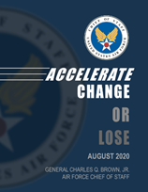




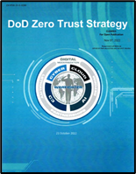
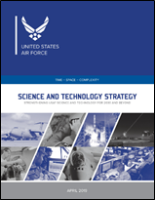

DAF Goals and Objectives
Enhance or accelerate development of an AF capability; or
Align with a DoD or AF strategic plan.

Slide 8
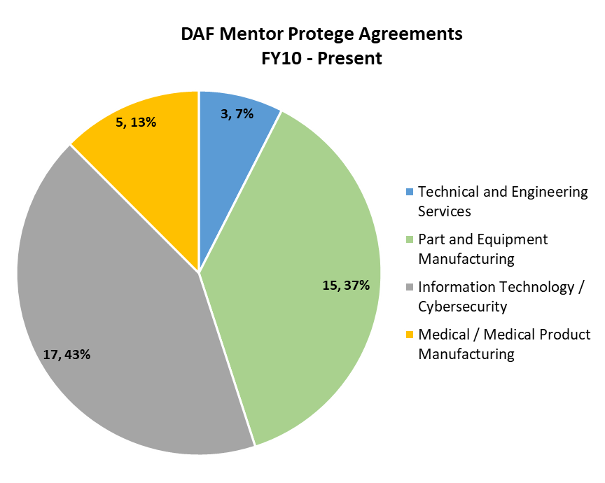
DAF Agreement Areas
DAF has been a part of the DoD MPP since 1992
Has successfully completed ~330 MPAs since start of the program
Currently have 13 active agreements
Data provided by D. Sikora and is current as of 01 Feb 2023

Slide 9
Program Updates
Significant changes made to the program in the National Defense Authorization Act (NDAA) For FY 2023 (Section 856)
DoD Mentor Protégé has been made permanent!
Codification of the DoD MPP
10 USC 4902 from 10 USC 4901 note
Initial agreement length changed from (2) to (3) years
Still able to extend to (5) years for “unusual circumstances”
Additional forms of assistance by Mentor personnel added
Added manufacturing and test and evaluation
Modified Mentor Firm eligibility
Level of contracts and subcontracts awarded in previous FY lowered to $25M (from $100M)

Slide 10
Program Updates
Established the “Protégé Technical Reimbursement Pilot Program”
More information by 01 Jul 2023
OSBP required to conduct an independent review of the program at least once every (3) years
Added a few new definitions
Affiliation, Small Business Concern, Small Business Concern owned and controlled by socially and economically disadvantaged individuals, and subcontracting participation goal.
Post award reporting increased from 2 to 5 years (DFARS - Dec22)
Note: Amendments made by the FY23 NDAA shall not apply with respect to any agreement entered into PRIOR to enactment of the FY23 NDAA

Slide 11
Protégé Benefits
Receive relevant technology transfer
Achieve required industry standards, lean processes and preparation for certifications
Business infrastructure enhancement
Develop long term business relationships with Mentor
Expand subcontracting opportunities
Business development and planning
Protégé may leverage technical expertise of mentor to bid on Small Business set aside contracts
Improve competitive advantage

Slide 12
Mentor Benefits
Develop long term business relationships with qualified small businesses
Develop effective and high-quality pool of eligible small businesses
Enhance technical capabilities of both firms
Pursue new market opportunities as a Mentor – Protégé Team
Award subcontracts to protégé on a noncompetitive basis while in the program
Receive cost reimbursement for assistance provided to protégé

Slide 13
DoD Benefits
Supports the warfighter
Brings innovative tech into established Defense Acquisition Programs
Develops a more capable small business defense industrial base (DIB) and robust supply chain
Ensures capacity & capability to support prime and subcontracting requirements
Fosters the establishment of long-term business relationships which benefit DoD and the DIB
Promotes other programs and resources that exist with the DoD
Protects our investments through cybersecurity hygiene and readiness

Slide 14
Forms of Assistance
A MPA agreement may provide for the Mentor to furnish any or all of the following types of developmental assistance:
Assistance by Mentor personnel in:
General business management, including organizational management, financial management, and personnel management, marketing, and overall business planning;
Engineering and technical matters such as production, inventory control, manufacturing, test and evaluation, and quality assurance; and
Any other assistance designed to develop the capabilities of the protege firm to:
Participate in DoD, Federal, and/or commercial contracts and subcontracts; and
Increase small business subcontracting opportunities in industry categories where eligible protégés or other small business firms are not dominant in the company’s vendor base.

Slide 15
Forms of Assistance
Assistance in understanding contract regulations of the Federal Government and DoD (FAR and DFARS);
Award of subcontracts to the Protégé firm under DoD contracts or other contracts on a noncompetitive basis;
Payment of progress payments for performance of the Protege firm under such a subcontract in amounts as provided for in the subcontract;
Advance payments under such subcontracts;
Loans; and
Assistance obtained by the Mentor for the Protege from one or more Authorized Subcontractor.

Slide 16
Authorized Subcontractors
Authorized Subcontractors
Historically Black Colleges and Universities (HBCUs)
Minority Serving Institutions (MSIs)
Small Business Development Centers (SBDCs)
Apex Accelerators (Formerly PTACs)
Manufacturing Extension Partnerships (MEPs)
Women Business Centers (WBCs)
Manufacturing Innovation Institutes (MIIs)
Independent 3rd Party Certifiers
All others require advance discussion and justification
Notes:
Follow definition of 20 U.S.C. 1067q on what qualified as a HBCU or MI
The U.S. Dept of Education is responsible for posting the U.S. Department of Education Accredited Minority Post-secondary Education list annually.

Slide 17
Mentor Eligibility
To be eligible to participate as a Mentor, an entity must:
Be eligible for the award of a Federal contracts;
Demonstrate that it:
Is qualified to provide assistance that will contribute to the purpose of the program;
Is of good financial health and character;
Is not on a Federal list of debarred or suspended contractors; and
Is an Other than Small Business concern, unless approved by OSBP;
and

Slide 18
Mentor Eligibility Con’t
Be capable of imparting value to a Protégé firm because of experience gained as DoD contractor or through knowledge of general business operations and government contracting, as demonstrated by evidence that such entity:
Received DoD contracts and subcontracts equal to or greater than $25M during the previous FY;
Is a Prime contractor to DoD with an active subcontracting plan;
Has graduated from the 8(a) Business Development Program and provides documentation of its ability to serve as a Mentor; or
Demonstrates the capability to assist in the development of Proteges firms.

Slide 19
Protégé Eligibility
To be eligible to participate as a Protégé, an entity must be:
A Small Business Concern;
Eligible for the award of Federal contracts;
Not more than the SBA size of standard for its primary North American Industry Classification System (NAICS) code;
Not owned or managed by individuals or entities that directly or indirectly have stock options or convertible securities in the Mentor firm; and

Slide 20
Protégé Eligibility Con’t
Be at least one of the following:
A qualified HUBZone small business concern;
A women-owned small business concern;
A service-disabled veteran-owned small business concern;
An entity owned and controlled by an Indian tribe;
An entity owned and controlled by a Native Hawaiian organization;
An entity owned and controlled by socially and economically disadvantaged individuals;
A qualified organization employing severely disabled individuals; or
A small business concern that:
Is a nontraditional defense contractor; or
Currently provides goods or services in the private sector that are critical to enhancing the capabilities of the defense supplier base and fulfilling key DoD needs.

Slide 21
Eligibility Concerns
A Mentor firm does not share, directly or indirectly, with the Protégé firm ownership of management of the Protégé firm;
The Mentor firm does not have an agreement, at the time the Mentor enters into a MPA, to merge with the Protégé firm;
The owners and managers of the Mentor firm are not the parent, child, spouse, sibling, aunt, uncle, niece, nephew, grandparent, grandchild, or first cousin of an owner or manager of the Protégé firm;
The mentor firm has not, during the 2-year period before entering into a mentor-protégé agreement, employed any officer, director, principal stockholder, managing member, or key employee of the protégé firm;

Slide 22
Eligibility Concerns
The mentor firm has not engaged in a joint venture with the protégé firm during the 2-year period before entering into a mentor-protégé agreement, unless such joint venture was approved by SBA prior to making any offer on a contract;
The mentor firm is not, directly or indirectly, the primary party providing contracts to the protégé firm, as measured by the dollar value of the contracts; and
The SBA has not made a determination of affiliation or control.

Slide 23
Types of Agreements: Directly Reimbursed
Direct Reimbursement of cost of developmental assistance:
Identify specific Service/Agency endorsement
Highly encouraged to use HBCU/MSI/SBDC/APEX/MEP/WBC/MII
Direct cost reimbursement of allowable costs outlined in DFARs Appendix I, including:
Direct labor costs (for assistance by Mentor firm employees)
Assistance provided by HBCU/MSI/SBDC/APEX/MEP/WBC/MII
Other costs
Service Components/Other Defense Agencies (ODAs) may have additional mission priorities and requirements
Requires Service Component/ODA Approval

Slide 24
Types of Agreements: Credit
Provides credit toward DoD subcontracting goals:
Requires Defense Contract Management Agency (DCMA) approval
More focused on business infrastructure
Costs incurred under Credit Agreement may be applied towards SDB subcontracting goals under any Federal Agency Subcontracting plan (FAR 19.703) in the following multiples:
4x for assistance provided by HBCU/MSI/SBDC/APEX, i.e. $400,000 SubK credit given if $100,000 in SDB assistance is provided by a DoD Mentor via an HBCU/MSI, SBDC, or APEX
3x for labor assistance by Mentor firm employees
2x other costs (example: travel or training)

Slide 25
Types of Agreements: Hybrid
Utilizes some credit and some reimbursement instead of exclusively one or the other
Hybrid Agreements start out as a Credit Agreement for the first year and then can be modified to include Reimbursable Agreement provisions for remainder of the agreement
Process
Development procedures similar to a reimbursement proposal
Agreement transformed to a formal contract document signed by both parties
Proposals can be submitted to DCMA MP Program Manager (PM) and servicing DoD Component PM for consideration
The base year (credit) amount must be proportionate with the reimbursable amount for the Option Year(s)

Slide 26
How to Get Started
Step 1: Establish a Counterpart
Mentors and Protégés are solely responsible for finding their counterpart. DoD participation in the teaming of Mentors and Protégés is prohibited. We strongly encourage firms to explore existing business relationships in an effort to establish a Mentor-Protégé relationship.
Communication, Compatibility, and Commitment are key to a successful Agreement!
Mentor, if not already approved, needs to submit a MPP Mentor Application to DoD OSBP
Located at: https://business.defense.gov/Programs/Mentor-Protege-Program/MPP-Resources/

Slide 27
How to Get Started
Step 2: Develop Agreement
Perform a thorough needs assessment of the Protégé. This includes assessing both:
Engineering and technical assistance needs and the
General business development assistance needs.
Developmental assistance should align with the Protégé's strategic vision.
Identify the quantitative and qualitative benefits to DoD
Develop the future statement of work, to include measurable milestones and identification of possible Authorized Subcontractors.
Determine the Type of Agreement (reimbursable, credit, or hybrid)
Communication, Compatibility, and Commitment are key to a successful Agreement!

Slide 28
How to Get Started
Step 3: Submit Agreement Proposal
Directly reimbursed agreement applications
Submitted to the Service or Component Small Business Office.
Credit agreement applications
Submitted to the Defense Contract Management Agency (DCMA)
Hybrid agreement applications
Submitted to the Service or Component Small Business Office and
DCMA.

Slide 29
How to Get Started
Step 4: Start Agreement
Credit agreements start on the date they are approved.
Directly reimbursed agreements start on the date the contract is signed and funds are obligated to the contract.
Step 5: Reporting
Air Force requires monthly reports and quarterly program management reviews.
DCMA conducts semi-annual and annual performance reviews.
Protégé is required to report annually with DCMA for five years after completion of each DoD MPP agreement.

Slide 30
Helpful Hints
Mentor
Recognize the Protégés limitations (resources and schedule)
Focus on the critical areas the Protégé needs in order to rise to the next level of qualifications for competitiveness for both prime and subcontract opportunities
The Authorized Subcontractors can be vital members of the team
Protégé
Realistically evaluate the level of investment needed (time and money)
First priority is being a business, somewhere after is being a Protégé
Focus on the critical areas….
Don’t be afraid to ask for assistance
Communication is key to success!

Slide 31
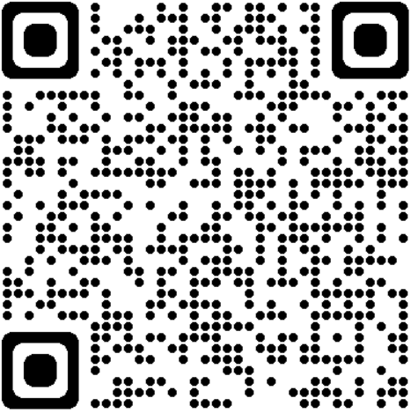
DEPARTMENT OF THE AIR FORCE (DAF) OFFICE OF SMALL BUSINESS PROGRAMS (SAF/SB)
Website QR Code
Facebook.com/
airforcesmallbiz
LinkedIn.com/
airforcesmallbiz
Twitter.com/
AFSmallBiz
Website: www.airforcesmallbiz.af.mil
Email: SAF.SB.workflow@us.af.mil

Slide 32
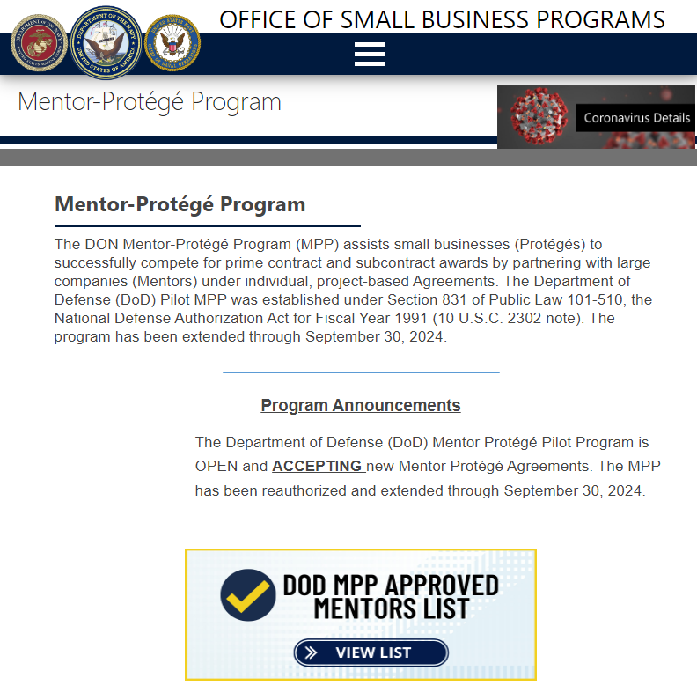
www.secnav.navy.mil/smallbusiness/pages/mentor-protege.aspx

Slide 33
Mentor Protégé Links
DON Mentor-Protégé Pgm: https://www.secnav.navy.mil/smallbusiness/pages/mentor-protege.aspx
DAF Mentor-Protégé Pgm: https://www.airforcesmallbiz.af.mil/Support-Programs/MENTOR-PROTEGE-Program/
DoD Mentor-Protégé Pgm: https://business.defense.gov/Programs/Mentor-Protege-Program/
SBA Mentor-Protégé Pgm: https://www.sba.gov/federal-contracting/contracting-assistance-programs/sba-mentor-protege-program

Slide 34

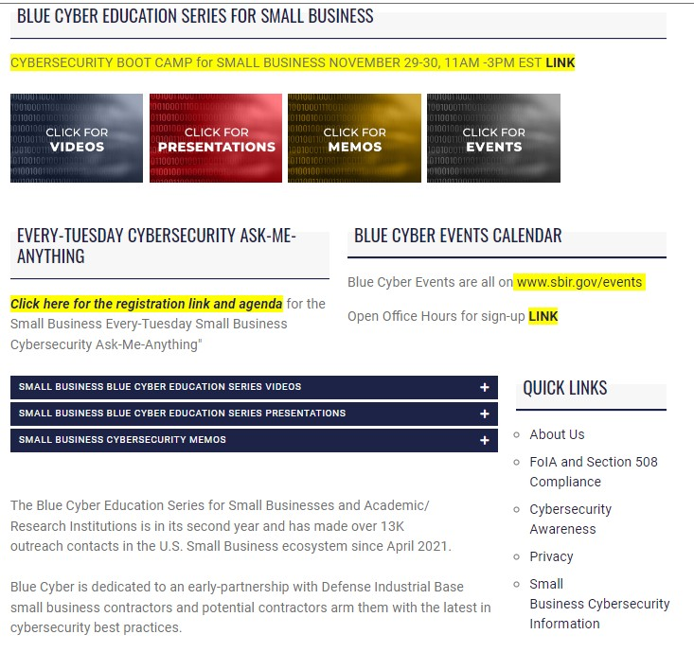
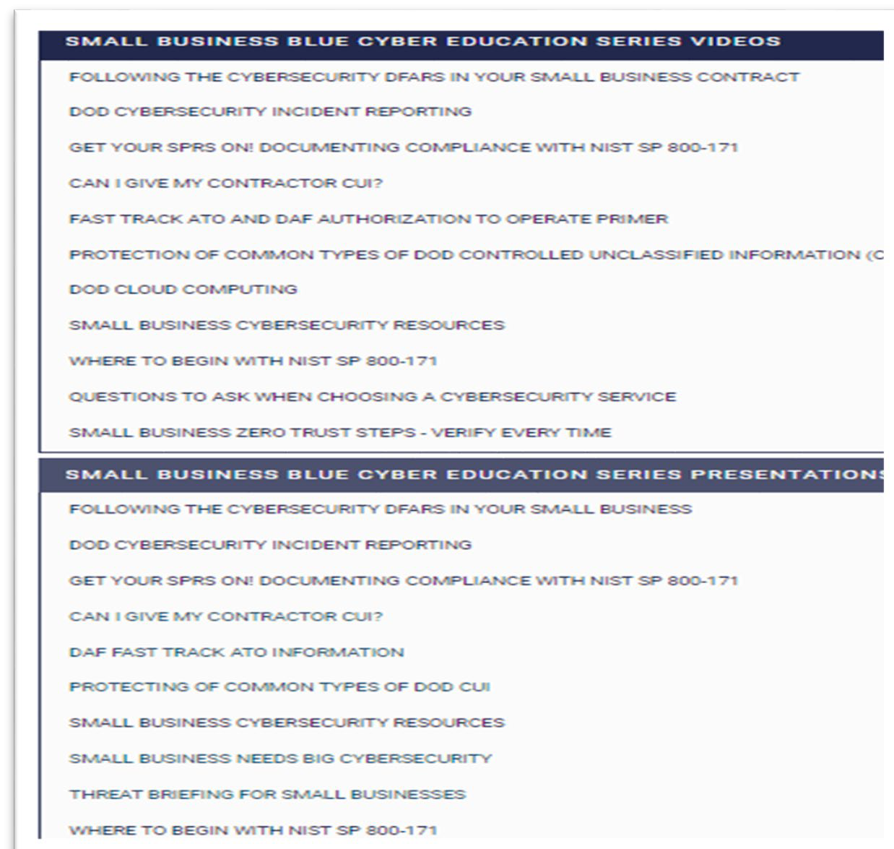
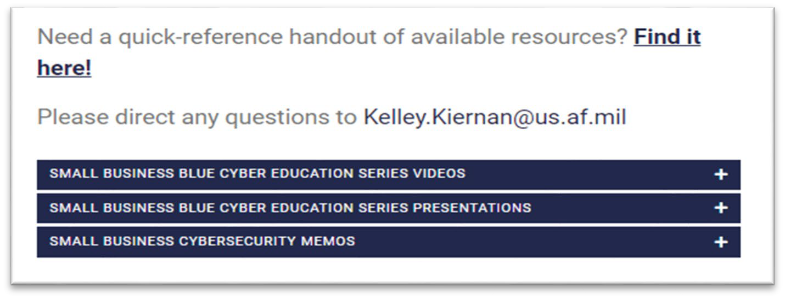
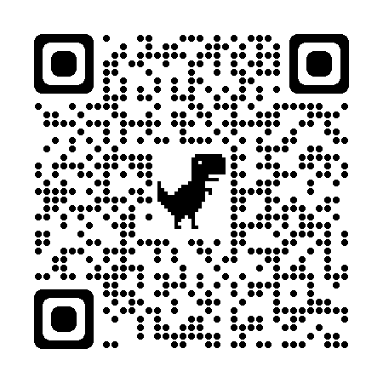
Approved, DCN# 543-117-23
D
O N C IS O ’ S BLU E C Y BER
The Blue Cyber Education Series for Small Businesses webpage
HERE
Daily Office Hours
for answering/researching your questions about Small Business cybersecurity and data protection!
All FREE and PUBLIC events can be found on www.sbir.gov/events
40 Presentations
40 Presentations
40 Total Presentations
29

